Slide 1
Title
Your name
Notes:
Example: Ed and Rony. Emphasize the emotions that each felt about the other and how that affected the outcome. Point out that their behavior was unproductive—not good for the team/organization, but rather for each of them to feel safe.

Slide 2
Introductions:
Name
Year, degree
I came to this session because...
Notes:
In pairs or trios:
Describe unproductive behaviors you see in your workplace (or with your clients). 2 min, 1 min report out
Describe unproductive behaviors you do yourself. 2 min, 1 min report out

Slide 3
Name
What you do
Why you are here
© 2013, The Schutz Company. All rights reserved.

Slide 4
An ideal organization
Accountability
Openness
Self-regard
Job Fit
Decision Making
Personal Development
Leadership
Productivity
Results
© 2015, The Schutz Company. All rights reserved.

Slide 5
An authentic, ideal organization
Accountability
People take responsibility for themselves and blaming is minimal.
Openness
People tell each other the truth.
Self-regard
People feel good about themselves and are fully present in what they do.
Job Fit
The organization selects, places, and reassigns people into the right jobs and assembles high performing teams.
Decision Making
Leads to motivation and creativity. People are inspired to do their best and do not fight, sabotage, or put others down.
Personal Development
People find more personal pleasure at the workplace and develop themselves continuously.
Leadership
Leaders model all of these characteristics and inspire people. They admit their mistakes and uncertainties and are open with employees.
Productivity
Absenteeism, illness, and lateness are dramatically reduced. Productivity is greatly increased.
Results
The organization produces exceptional results: financial, social, and environmental.
© 2015, The Schutz Company. All rights reserved.

Slide 6
Describe unproductive behaviors you see in your workplace.
Describe unproductive behaviors you do yourself.
Notes:
In pairs or trios:
Describe unproductive behaviors you see in your workplace (or with your clients). 2 min, 1 min report out
Describe unproductive behaviors you do yourself. 2 min, 1 min report out

Slide 7
What would happen
if you could reduce or eliminate these unproductive behaviors in your workplace?

Slide 8
Problem solving & creative
0
Unproductive
& reactive
Notes:
Potential – eliminating unproductive behaviors is like a deficit model. Good, but doesn’t go to the positive.

Slide 9
What could you do if you not only eliminated unproductive behaviors, but fully reached your potential?

Slide 10
What would happen if everyone you work with fully reached his/her potential?

Slide 11
Individual
People
System
Task
Service
Product
Process
Network
Relationships
Compatibility
Individual
Individual
© 2013, The Schutz Company. All rights reserved.

Slide 12
Task
System
People
Individual
Individual
Individual
Relationships
Compatibility
Process
Network
Service
Product
© 2013, The Schutz Company. All rights reserved.

Slide 13
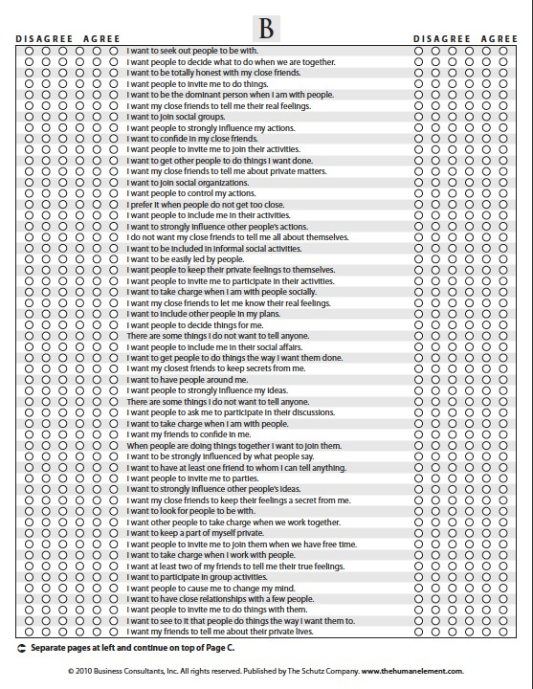
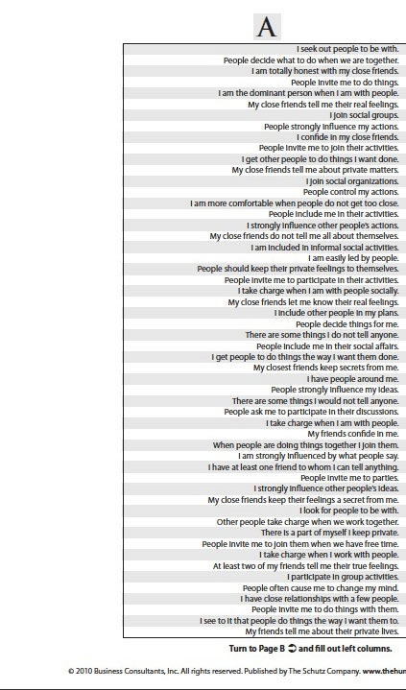
Completing Element B
Respond to each item using bubbles on right
© 2013, The Schutz Company

Slide 14
Completing Element B
Respond to each item using bubbles on left
© 2013, The Schutz Company

Slide 15
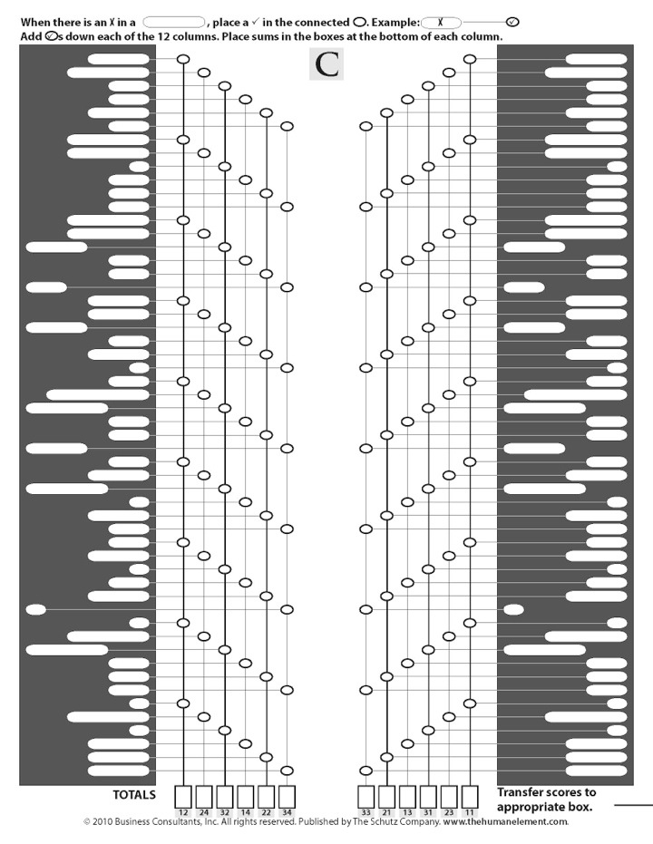
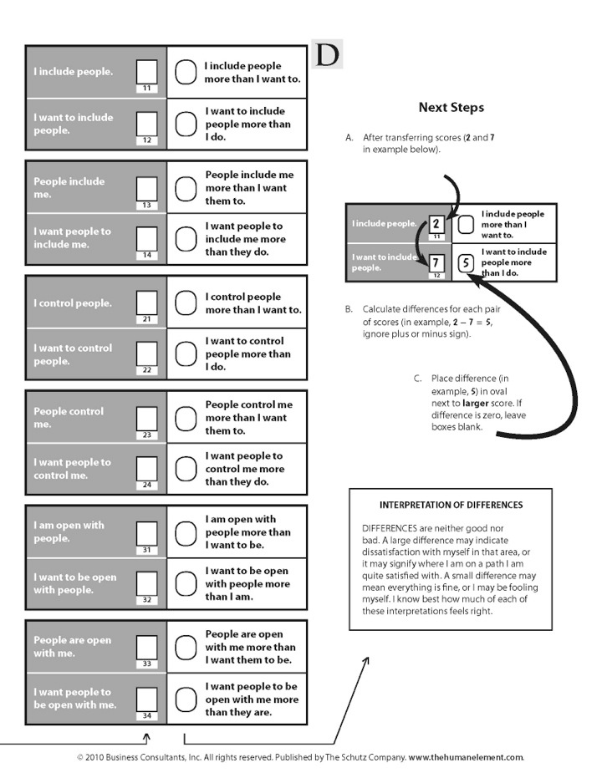
Completing Element B
© 2014, The Schutz Company. All rights reserved.

Slide 16
Scoring Element B
© 2014, The Schutz Company. All rights reserved.

Slide 17
Scoring Element B
P
P
P
P
P
P
© 2014, The Schutz Company. All rights reserved.

Slide 18
P
Scoring Element B
P
Total check marks in each column and place sum in box at bottom
7
© 2014, The Schutz Company. All rights reserved.

Slide 19
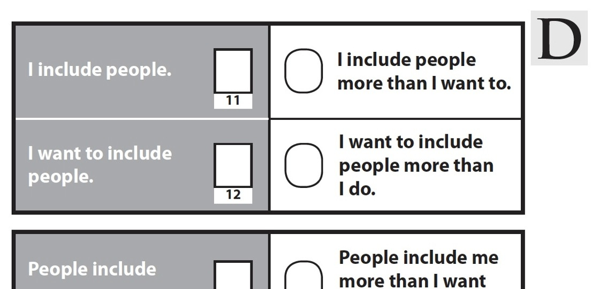
Scoring Element B
Transfer the scores at the bottom of page C to page D using the codes under each box.
8
1
7
7
6
1
8
9
4
3
3
6
7
9
8
© 2014, The Schutz Company. All rights reserved.

Slide 20
Make decisions
Handle conflict
Listen to others
Speak to others
View others
Use our time and energy
How we feel about ourselves at work
© 2012, The Schutz Company
Notes:
Here’s why: When we feel good…and when we don’t. Affects the way we:
• Make decisions
• Handle conflict
• Listen & speak to others
• View others
• Use our time and energy
Focus
Think
Solve problems

Slide 21
How We Feel About Ourselves at Work
Notes:
Here’s why: When we feel good…and when we don’t. Affects the way we:
• Make decisions
• Handle conflict
• Listen & speak to others
• View others
• Use our time and energy
Focus
Think
Solve problems

Slide 22
Working well together
is driven by…
Individual feelings
about oneself
in the organization
© 2012, The Schutz Company

Slide 23
Why does this happen?
What can we do about it?
Notes:
So, the important questions are, why does this happen and what can we do about it? If we understand why we feel the way we do at work, we can take steps to create workplaces where people feel good about themselves and bring their best selves to the work.
This is why THE starts with the individual

Slide 24
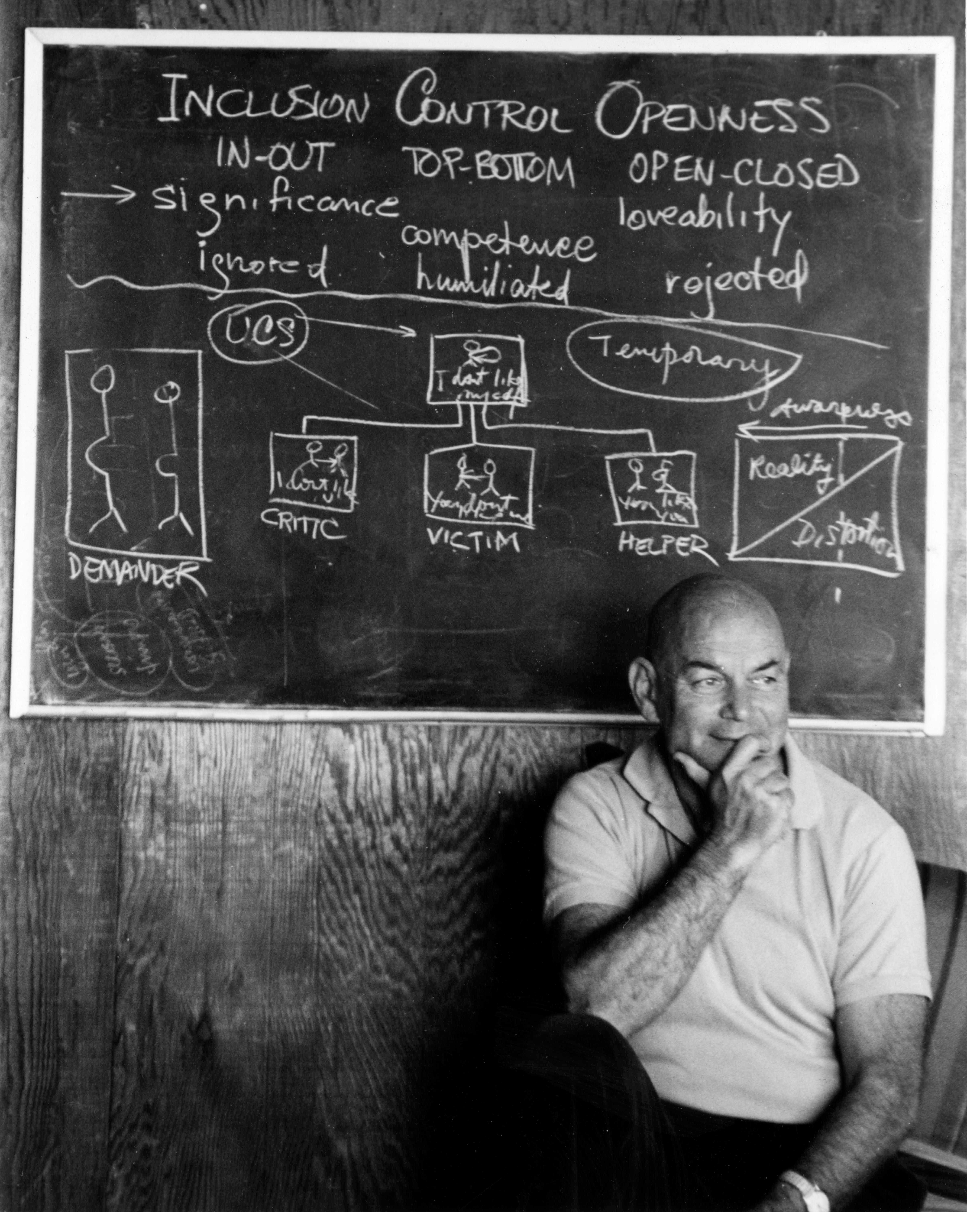
Will Schutz, Ph.D.
1925-2002
Notes:
“…how to integrate the men and machines…”
“When I came to the Naval Research Laboratory they were looking for someone in social science to take care of the man aspect of the man-machine problem. My work … has been therefore to try to devise methods and in order to do this to get basic information about how men can work most productively together, what are the most effective ways of constructing teams so that men will cooperate and be able to function at a high level of efficiency …This work, I might say, is of great interest to me for various reasons. One is the obvious application that I mentioned; another is that it has many implications for basic psychological work, which I am of course interested in. And the third is a personal reason which I think originated very early in my life and which I can trace at least as far back as high school. …The thing that I am really mainly interested in as far as my social and political and academic beliefs are concerned is the dignity of individual people, the possibility of having people realize themselves, …In the work that I am doing I am working with a concept called compatibility, and the main idea of this is the following: that if people are basically compatible as far as their personalities are concerned, they will be able to work together efficiently. This means that you can take someone who is ordinarily quite rejected by the rest of his fellow members or crew members, whatever the situation, and put him in a group in which he will be accepted and he will be able to express himself to a very considerable degree. Now this has the practical advantage of making the team more productive. It also has, what is for me, a very satisfying advantage in helping someone to realize himself personally. [This stems] from my interest in things that are called in the political sphere civil liberties and psychologically they are called free expression and self realization, and terms of this type. And I think that most of the strong feelings that I had toward particular issues stem from this one basic feeling that I have in general.”

Slide 25
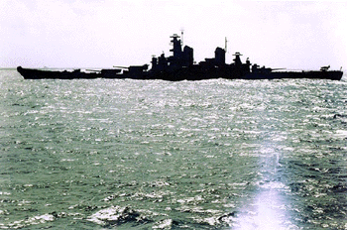
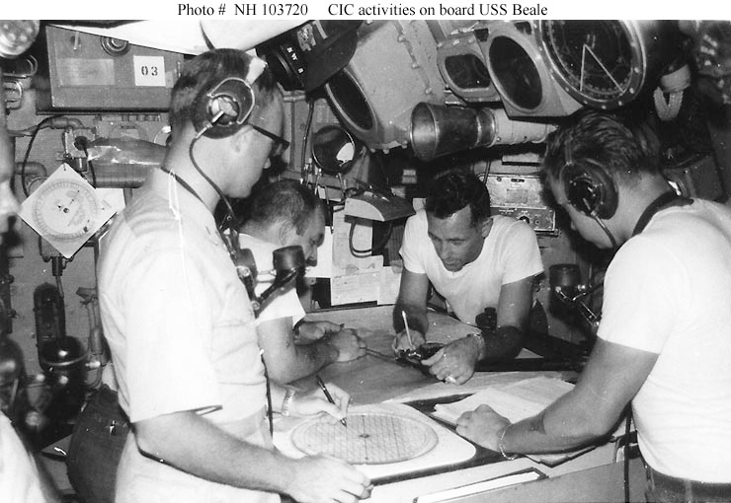
Notes:
Original research
Technical competence a given
C-P effect, magnified when under pressure
Applied to tasks where interdependence is higher

Slide 26
Technical competence
Compatibility
People working well together

Slide 27
C P
Compatibility is directly
related to Productivity
© 2013, The Schutz Company. All rights reserved.
Notes:
Technical competence given

Slide 28
C P
Productive teams created randomly:
50%
Productive teams created using FIRO:
75%
© 2013, The Schutz Company. All rights reserved.
Notes:
Technical competence given

Slide 29
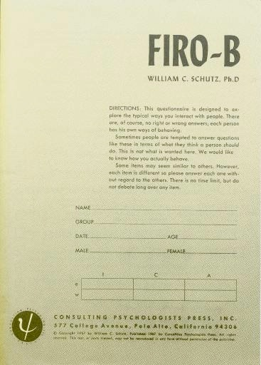
FIRO
Fundamental
Interpersonal
Relations
Orientation

Slide 30
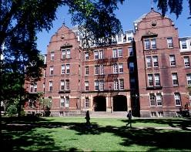
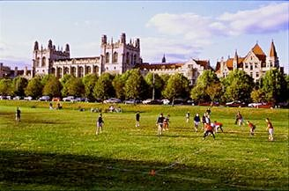
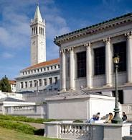
Harvard
University of Chicago
University of California Berkeley
Albert Einstein School of Medicine
Notes:
Berkeley – large study on FIRO theory
Einstein – work with psychotic patients. Noticed that the “outlaws”—NTL, encounter people--did better. Talked to people, listened, used body methods.

Slide 31
Inclusion Low High | Control Low High | Openness Low High
FIRO-B predicted behavior 75% accurately
What explained the other 25%?
© 2013, The Schutz Company. All rights reserved.
Notes:
This question pushed the rest of his career
In NY: psychosynthesis, spiritually oriented technique using imagery (Assagioli)
Psychodrama (Moreno)
Bioenergetics (Lowen and Pierrakos)
Rolfing
Gestalt therapy
All included imagery and body methods

Slide 32
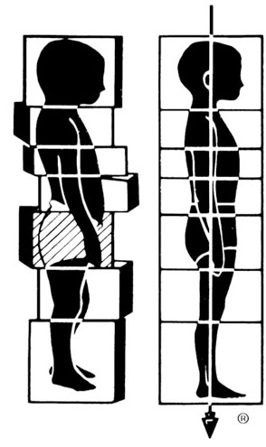
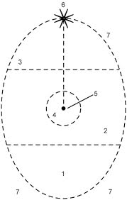
Psychodrama
Bioenergetics
Psychosynthesis
Rolfing
© 2013, The Schutz Company. All rights reserved.

Slide 33
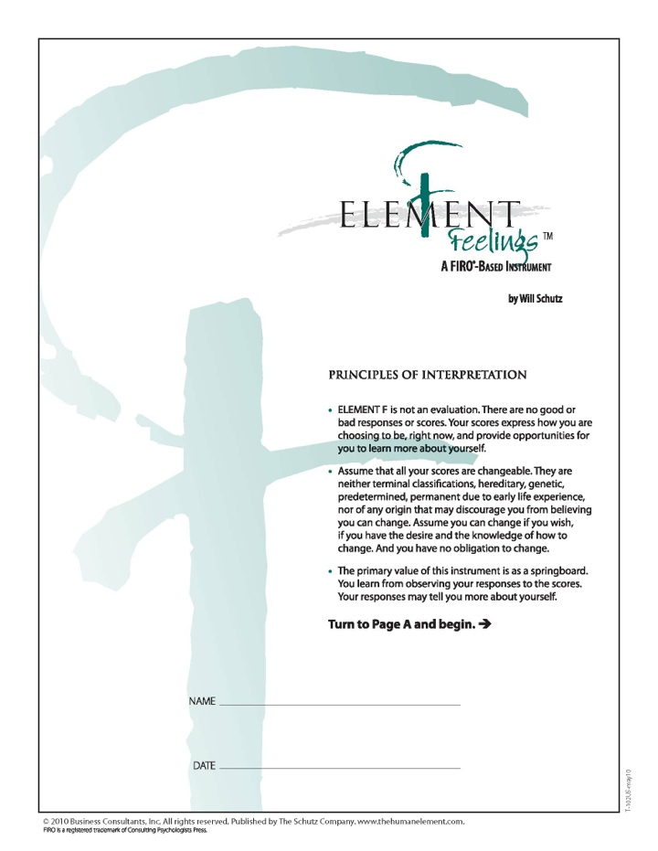
Behavior | Inclusion | Control | Openness
Feelings | Significance | Competence | Likability
Self-Concept (behavior) | Aliveness | Self-Determination | Self-Awareness
Self-Concept (feelings) | Self-Significance | Self-Competence | Self-Like
© 2013, The Schutz Company. All rights reserved.

Slide 34
Behavior | Inclusion | Control | Openness
Feelings | Significance | Competence | Likability
Self-Concept (behavior) | Aliveness | Self-Determination | Self-Awareness
Self-Concept (feelings) | Self-Significance | Self-Competence | Self-Like
© 2013, The Schutz Company. All rights reserved.

Slide 35
Behavior | Inclusion | Control | Openness
FIRO®
Fundamental
Interpersonal
Relations
Orientation
Feelings | Significance | Competence | Likability
Self-Concept (behavior) | Aliveness | Self-Determination | Self-Awareness
Self-Concept (feelings) | Self-Significance | Self-Competence | Self-Like

Slide 36
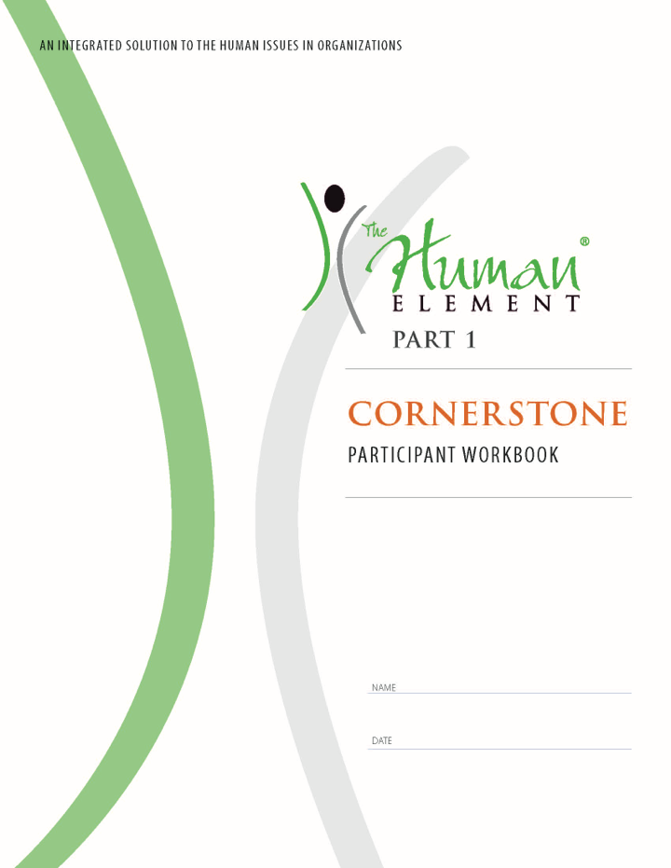
Feedback
Imagery/Visualization
Assessment Tools
Structured
Experiences
Self-Perception

Slide 37
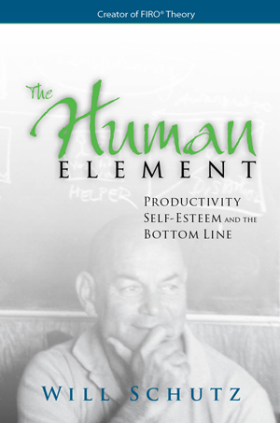
Maximize potential
Individuals
Teams
Organizations
Notes:
Org can’t give self-esteem. Managers can’t give self-esteem. Advice doesn’t work for self-esteem. Very important to understand.
Therefore, creating deep and long-lasting change in organizations cannot be done directly. Must change self-esteem and culture to do this. Org and mgrs can create conditions where it is most likely that people will have higher self-esteem.

Slide 39
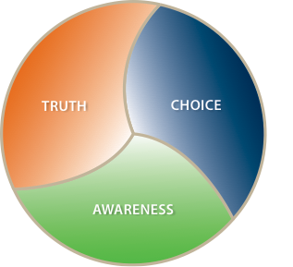

Slide 40
Transformation happens
from the inside out
© 2014, The Schutz Company. All rights reserved.

Slide 41
Truth
Personal truth = Sum total of my experience:
Feelings
Thoughts
Self-talk
State of my body
Memories
Sensations
Assumptions
Beliefs
© 2015, The Schutz Company. All rights reserved.

Slide 42
Openness
My experience
Body language
Slips
Tone
Unaware
Aware
Withholding
Distorting
Honesty
Misleading
Lying
Spin
White lies
You
© 2013, The Schutz Company. All rights reserved.

Slide 43
Our Unspoken Working Agreement
“Please Lie to Me”
I won’t…
…say what I see if you won’t say what you see.
…say what I’m thinking if you won’t say what you’re thinking.
© 2013, The Schutz Company. All rights reserved.

Slide 44
Our Unspoken Working Agreement
“Please Lie to Me”
I won’t…
…say what I’m really feeling if you won’t say what you’re really feeling.
…say what I want if you won’t say what you want.
…question you if you won’t question me.
© 2013, The Schutz Company. All rights reserved.

Slide 45
I pretend…
…to trust people who I don’t.
…to listen to people when I’m not.
…to respect certain people when I don’t.
…to agree when I don’t.
…I don’t have to be right or get my way.
…to be patient.
…I want to be collaborative.
…I’m not feeling critical.
© 2013, The Schutz Company. All rights reserved.

Slide 46
I pretend…
…not to be frustrated when I am.
…to know what I am doing when I don’t.
…not to be afraid when I am.
…I don’t want more recognition.
…to want other people’s opinions.
…I have things under control.
…I want feedback.
…to say what I think and feel.
© 2013, The Schutz Company. All rights reserved.

Slide 47
Everyone is 100% responsible for our situation and no one is to blame.
BLAME
A problem solving orientation
© 2012, The Schutz Company

Slide 48
Levels of Openness
-1 |  | (Unaware)
0 |  | (Withholding)
1 |  | “You are…”
2 |  | “Toward you I feel…”
3 |  | “Because you…”
4 |  | “I imagine you feel I…”
5 |  | “I fear I am…”
© 2013, The Schutz Company. All rights reserved.

Slide 49
Truth is the grand simplifier
© 2013, The Schutz Company. All rights reserved.

Slide 50
Behavior | Inclusion | Control | Openness
© 2013, The Schutz Company. All rights reserved.

Slide 51
Inclusion
0 | 1 | 2 | 3 | 4 | 5 | 6 | 7 | 8 | 9
Low
High
The amount of contact with other people
© 2013, The Schutz Company. All rights reserved.

Slide 52
Control
0 | 1 | 2 | 3 | 4 | 5 | 6 | 7 | 8 | 9
Low
High
The structure of the interaction with other people, including directing and decision-making
© 2013, The Schutz Company. All rights reserved.

Slide 53
Openness
0 | 1 | 2 | 3 | 4 | 5 | 6 | 7 | 8 | 9
Low
High
The depth of the interaction with other people—expressing feelings, thoughts, and beliefs
© 2013, The Schutz Company. All rights reserved.

Slide 54
Inclusion Low High | Control Low High | Openness Low High
Openness
The depth of the interaction with other people—expressing feelings, thoughts, and beliefs
Control
The structure of interaction with other people, including directing and decision-making
Inclusion
The amount of contact with other people
Notes:
Berkeley – large study on FIRO theory
Einstein – work with psychotic patients. Noticed that the “outlaws”—NTL, encounter people--did better. Talked to people, listened, used body methods.

Slide 55
Principles of Interpretation
The scores:
are not right or wrong, good or bad, or best and worst
snapshot in time
meaning from each person’s interpretation
springboards for discussion
beginning of the exploration
0 | 1 | 2 | 3 | 4 | 5 | 6 | 7 | 8 | 9
Strongly Agree |  |  |  |  | Strongly Disagree

Slide 56
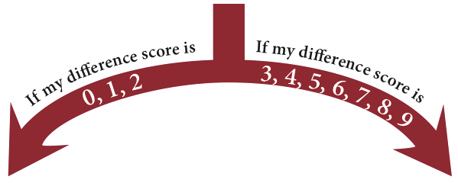
Principles of Interpretation
Difference scores:
A small difference score (0-2) may mean you are:
satisfied with your situation, or
deceiving yourself into believing you are satisfied
A large difference score (3-9) may mean you are:
dissatisfied with your situation, or
satisfied with your path and your progress

Slide 57
Principles of Interpretation
When reviewing your scores:
Notice that your own reactions can be as important as the numbers themselves
If you feel the scores are incorrect, explore the implications as if they were accurate
Consider that high or low can be relative
0 | 1 | 2 | 3 | 4 | 5 | 6 | 7 | 8 | 9
Strongly Agree |  |  |  |  | Strongly Disagree

Slide 58
Step 1: Your Element B Scores
Pages 11-12
Step 2: Difference Scores
Pages 13-17

Slide 59
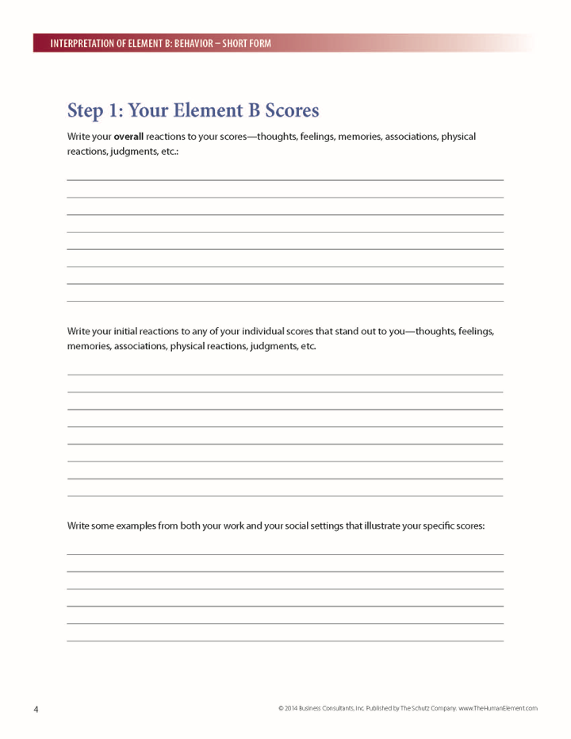
Step 1: Your Element B Scores
Page 4
© 2014, The Schutz Company. All rights reserved.

Slide 60
Step 2: Difference Scores
A small difference score (0-2) may mean you are:
satisfied with your situation, or
deceiving yourself into believing you are satisfied
A large difference score (3-9) may mean you are:
dissatisfied with your situation, or
satisfied with your path and your progress
© 2014, The Schutz Company. All rights reserved.

Slide 61
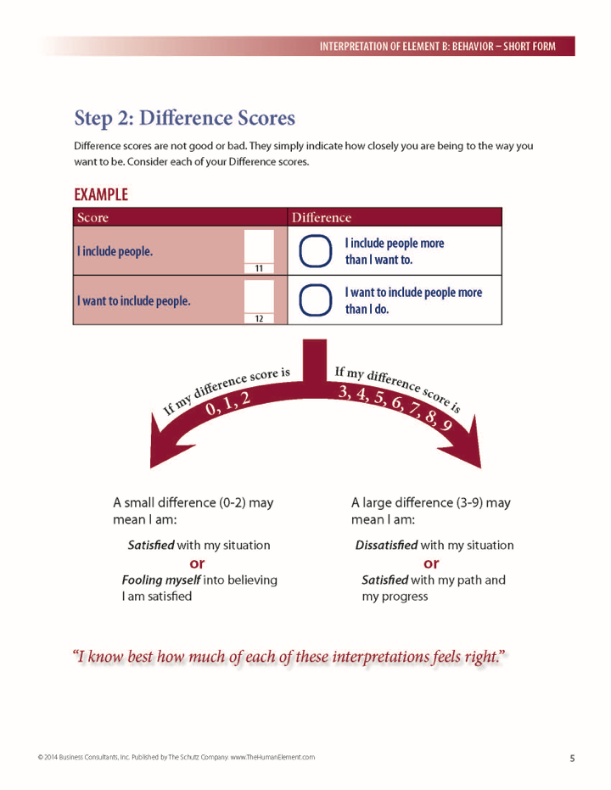
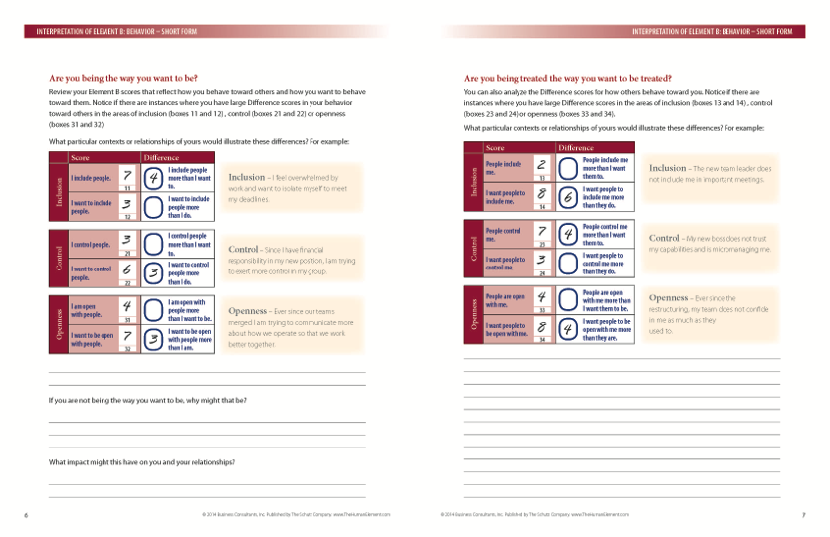
Step 2: Difference Scores
Pages 5-7
© 2014, The Schutz Company. All rights reserved.

Slide 62
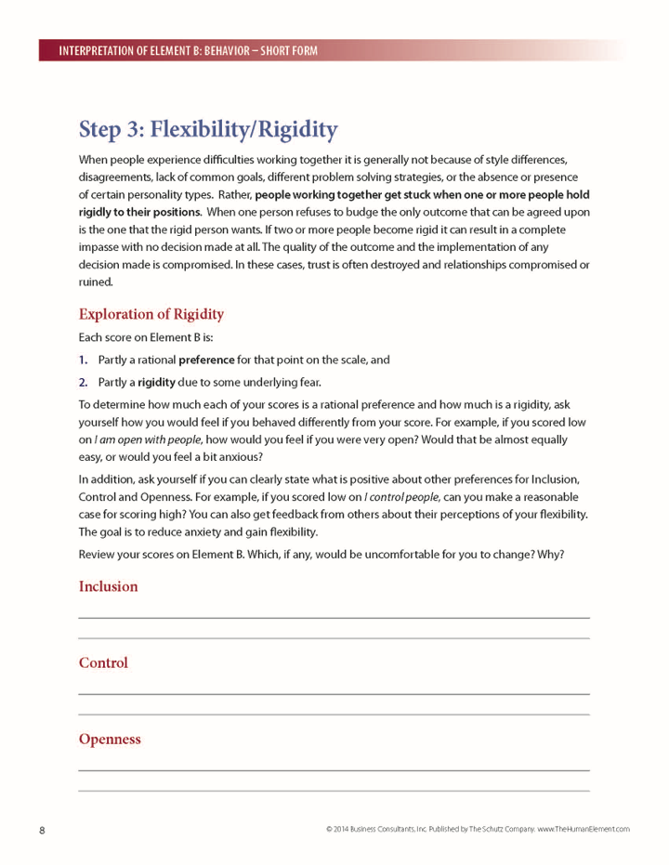
Step 3: Flexibility/Rigidity
Page 8
© 2014, The Schutz Company. All rights reserved.

Slide 63
Step 3: Flexibility/Rigidity
Pages 18-20

Slide 64
There are no good or bad scores.
However, we all judge other people.
And ourselves.
If we are unaware of this,
it interferes with our relations with others.
© 2014, The Schutz Company. All rights reserved.

Slide 65
Inclusion
0 | 1 | 2 | 3 | 4 | 5 | 6 | 7 | 8 | 9
Lower Scores |  |  | Middle Scores |  |  |  | Higher Scores
Negative
Withdrawn |  |  |  | Uncommitted |  |  | Overly social, chatty
Reclusive |  |  |  | Half-hearted |  |  | Exhibitionistic
Aloof, distant, loner |  |  |  | Indifferent |  |  | Dependent
Positive
Independent |  |  |  | Healthy boundaries |  |  | Highly engaged
Selective |  |  |  | Moderately social |  |  | Gregarious
Self-sufficient |  |  |  | Discriminating |  |  | Charismatic
© 2014, The Schutz Company. All rights reserved.

Slide 66
Control
0 | 1 | 2 | 3 | 4 | 5 | 6 | 7 | 8 | 9
Lower Scores |  |  | Middle Scores |  |  |  | Higher Scores
Negative
Complacent, indecisive |  |  |  | Unpredictable |  |  | Controlling
Weak, passive |  |  |  | Hesitant |  |  | Hostile, demanding
Avoiding responsibility |  |  |  | Waffling |  |  | Power hungry
Positive
Following |  |  |  | Diplomatic |  |  | Leading
Easygoing |  |  |  | Influencing |  |  | Directing
Permitting, tolerant |  |  |  | Flexible |  |  | Decisive
© 2014, The Schutz Company. All rights reserved.

Slide 67
Openness
0 | 1 | 2 | 3 | 4 | 5 | 6 | 7 | 8 | 9
Lower Scores |  |  | Middle Scores |  |  |  | Higher Scores
Negative
Stonewalling, tight-lipped |  |  |  | Strategically open |  |  | Gossiping, blabbing
Secretive, withholding |  |  |  | Cagey |  |  | Overly personal
Emotionally unavailable |  |  |  | Not caring |  |  | Melodramatic
Positive
Unflappable |  |  |  | Judicious |  |  | Expressive
Keeping confidences |  |  |  | Considered |  |  | Candid
Prudent |  |  |  | Thoughtful |  |  | Honest
© 2014, The Schutz Company. All rights reserved.

Slide 68
Behavior | Inclusion | Control | Openness
Interpersonal Fear | Ignored/Abandoned | Humiliated/Embarrassed | Rejected/Disliked

Slide 69
Behavior | Inclusion | Control | Openness
Interpersonal Fear | Ignored/Abandoned | Humiliated/Embarrassed | Rejected/Disliked
© 2013, The Schutz Company. All rights reserved.

Slide 70
Feelings | Significance | Competence | Likability
Interpersonal Fear | Ignored/Abandoned | Humiliated/Embarrassed | Rejected/Disliked
© 2013, The Schutz Company. All rights reserved.

Slide 71
Interpersonal fears can lead to...
Rigidity
© 2013, The Schutz Company. All rights reserved.

Slide 72
Goals
Flexibility/less rigidity
Openness
© 2014, The Schutz Company. All rights reserved.

Slide 73
Rigidity
Enemy of teamwork

Slide 74
Rigidity
Enemy of teamwork and good relationships
© 2013, The Schutz Company. All rights reserved.

Slide 75
Rigidity
Enemy of teamwork and collaboration
© 2013, The Schutz Company. All rights reserved.

Slide 76
Rigidity
...stems from fears
© 2013, The Schutz Company. All rights reserved.

Slide 77
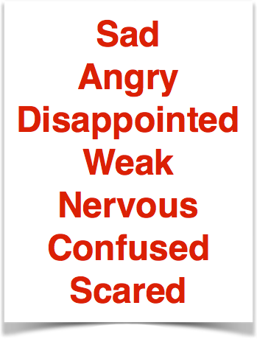
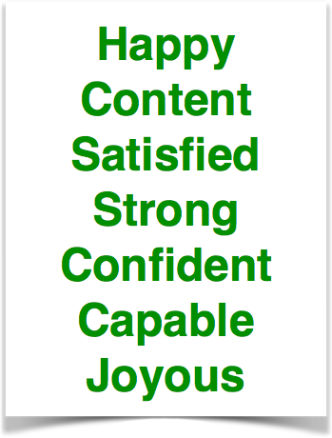
© 2013, The Schutz Company. All rights reserved.

Slide 78
Make decisions
Solve problems
Handle conflict
Listen to others
Speak to others
View others
Use time and energy
Fear affects our capacity to
© 2013, The Schutz Company. All rights reserved.

Slide 79
Inclusion Low High | Control Low High | Openness Low High
Ignored/Abandoned | Humiliated/Embarrassed | Rejected/Disliked
© 2013, The Schutz Company. All rights reserved.

Slide 80
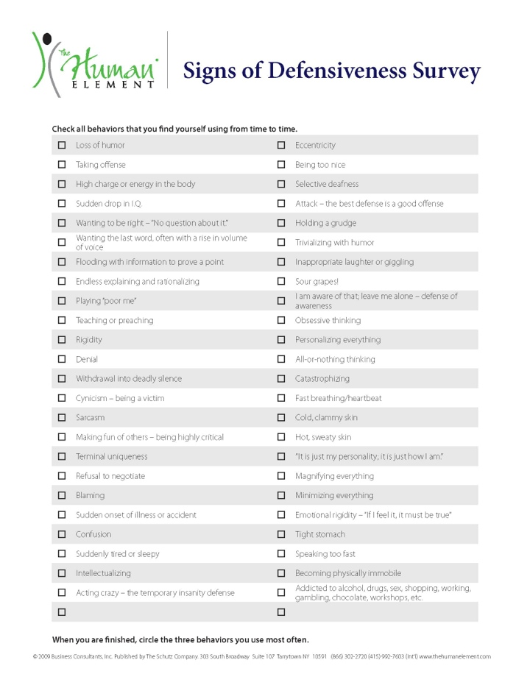
Notes:
Signs of Defensiveness survey. How do we know when we are getting rigid/defensive? What can we do about it?

Slide 81
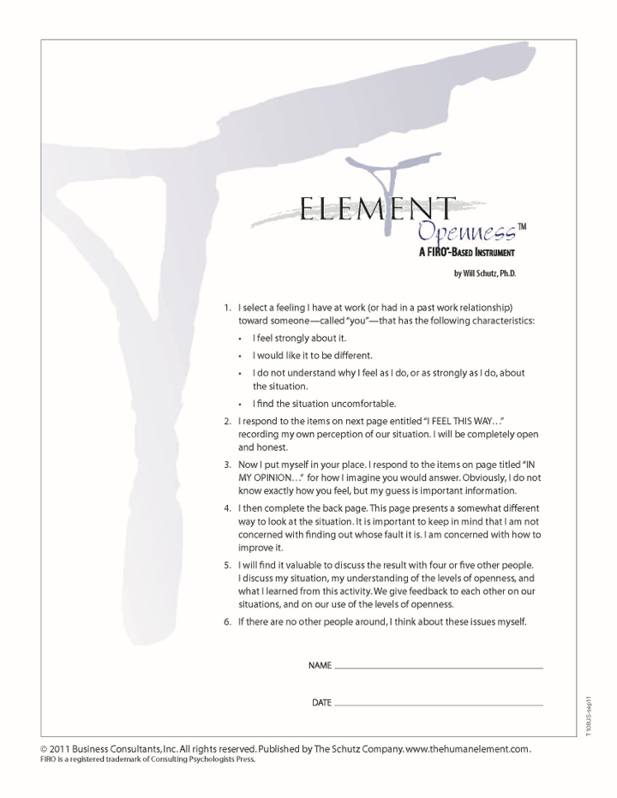
© 2013, The Schutz Company. All rights reserved.

Slide 82
Opening a Restaurant How will you invite your customers to feel:
Included and significant | Competent and in Control of their experience | Liked and treated in an Open, friendly way
and reduce concerns they have about being:
ignored passed over neglected unimportant forgotten | humiliated shamed embarrassed foolish stupid | rejected disliked judged harshly treated coldly not accepted
© 2013, The Schutz Company. All rights reserved.

Slide 83
Organizational Goals
 | Individuals feel… | Organization facilitates an atmosphere of…
Inclusion | Alive | Participation
Control | Self-determined | Empowerment
Openness | Self-aware | Openness
Significance | Significant | Recognition
Competence | Competent | Reward
Likability | Likable | Humanity
© 2012, The Schutz Company
Notes:
Tie to dimensions

Slide 84
COURSE
Part 1: Cornerstone
Foundational material—key tools, awareness
Part 2: Organizational Solutions
Compatibility among people
Difficult conversations
Teamwork
One-on-one relationships
Group decision-making

Slide 85
Applications
Leadership
Teamwork
Individual effectiveness
Coaching
Collaboration
Customer service
Career planning

Slide 86
Applications
Leadership
Teamwork
Personal effectiveness
Coaching
Collaboration
Customer service
Career selection

Slide 87
Application Courses
Radical Collaboration®
The Implicit Career Search
The Human Element in Customer Relations

Slide 88
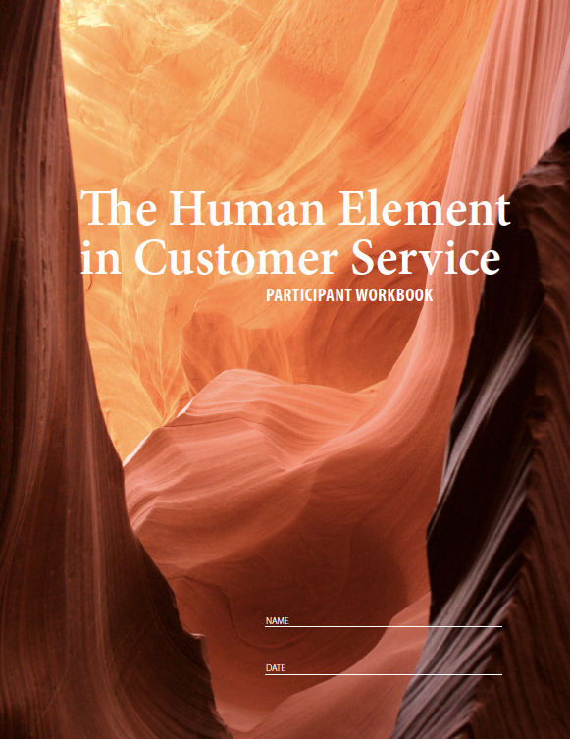
The Implicit Career Search®
The Human Element® in Customer Service
© 2013, The Schutz Company. All rights reserved.
Notes:
Radical Collaboration teaches collaboration, negotiation, and conflict resolution skills; The Human Element in Customer Service is designed to empower service providers to utilize their own skills to create customer delight; and The Implicit Career Search helps people determine and deliver their own unique contribution to the world.

Slide 89
POWERED BY THE HUMAN ELEMENT
© 2015, The Schutz Company. All rights reserved.

Slide 90
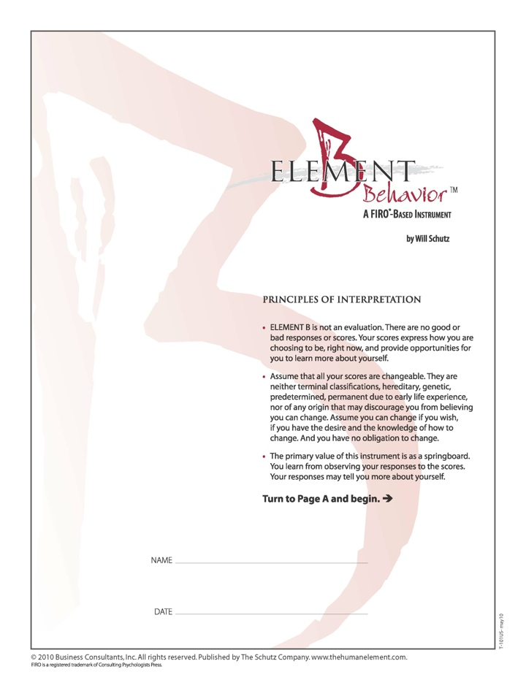
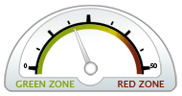
© 2014, The Schutz Company. All rights reserved.

Slide 91
Five Essential Skills for creating collaborative environments:
Collaborative Intention
Truthfulness
Self-Accountability
Self-Awareness and Awareness of Others
Problem Solving and Negotiating
© 2015, The Schutz Company. All rights reserved.

Slide 92
Industries
Automotive
Defense
Education
Energy
Food products
Financial services
Government
Healthcare
Information technology
Insurance
Manufacturing
Oil & Gas
Pharmaceuticals
Transportation
Utilities

Slide 93
Partial Client List
NASA
Memorial Sloan-Kettering Cancer Center
US Army
United Nations
Boeing
Lend Lease
Shell
Eli Lilly
Abbott Labs
Chubb & Son
Procter & Gamble
Seagrams
Sanofi-Aventis
Idaho Power
Christian Hansen
National Cancer Institute

Slide 94
Global Partners
United States
Canada
Mexico
Brazil
UK
France
Sweden
Norway
Finland
Denmark
Netherlands
Turkey
New Zealand
Japan
Korea
China

Slide 95
www.TheHumanElement.com
your email
© 2015, The Schutz Company. All rights reserved.

