Slide 1
Title
Location
Your Name
© 2015, The Schutz Company. All rights reserved.

Slide 2
An ideal organization
Accountability
Openness
Self-regard
Job Fit
Decision Making
Personal Development
Leadership
Productivity
Results
© 2015, The Schutz Company. All rights reserved.

Slide 3
An authentic, ideal organization
Accountability
People take responsibility for themselves and blaming is minimal.
Openness
People tell each other the truth.
Self-regard
People feel good about themselves and are fully present in what they do.
Job Fit
The organization selects, places, and reassigns people into the right jobs and assembles high performing teams.
Decision Making
Leads to motivation and creativity. People are inspired to do their best and do not fight, sabotage, or put others down.
Personal Development
People find more personal pleasure at the workplace and develop themselves continuously.
Leadership
Leaders model all of these characteristics and inspire people. They admit their mistakes and uncertainties and are open with employees.
Productivity
Absenteeism, illness, and lateness are dramatically reduced. Productivity is greatly increased.
Results
The organization produces exceptional results: financial, social, and environmental.
© 2015, The Schutz Company. All rights reserved.

Slide 4
© 2015, The Schutz Company. All rights reserved.

Slide 5
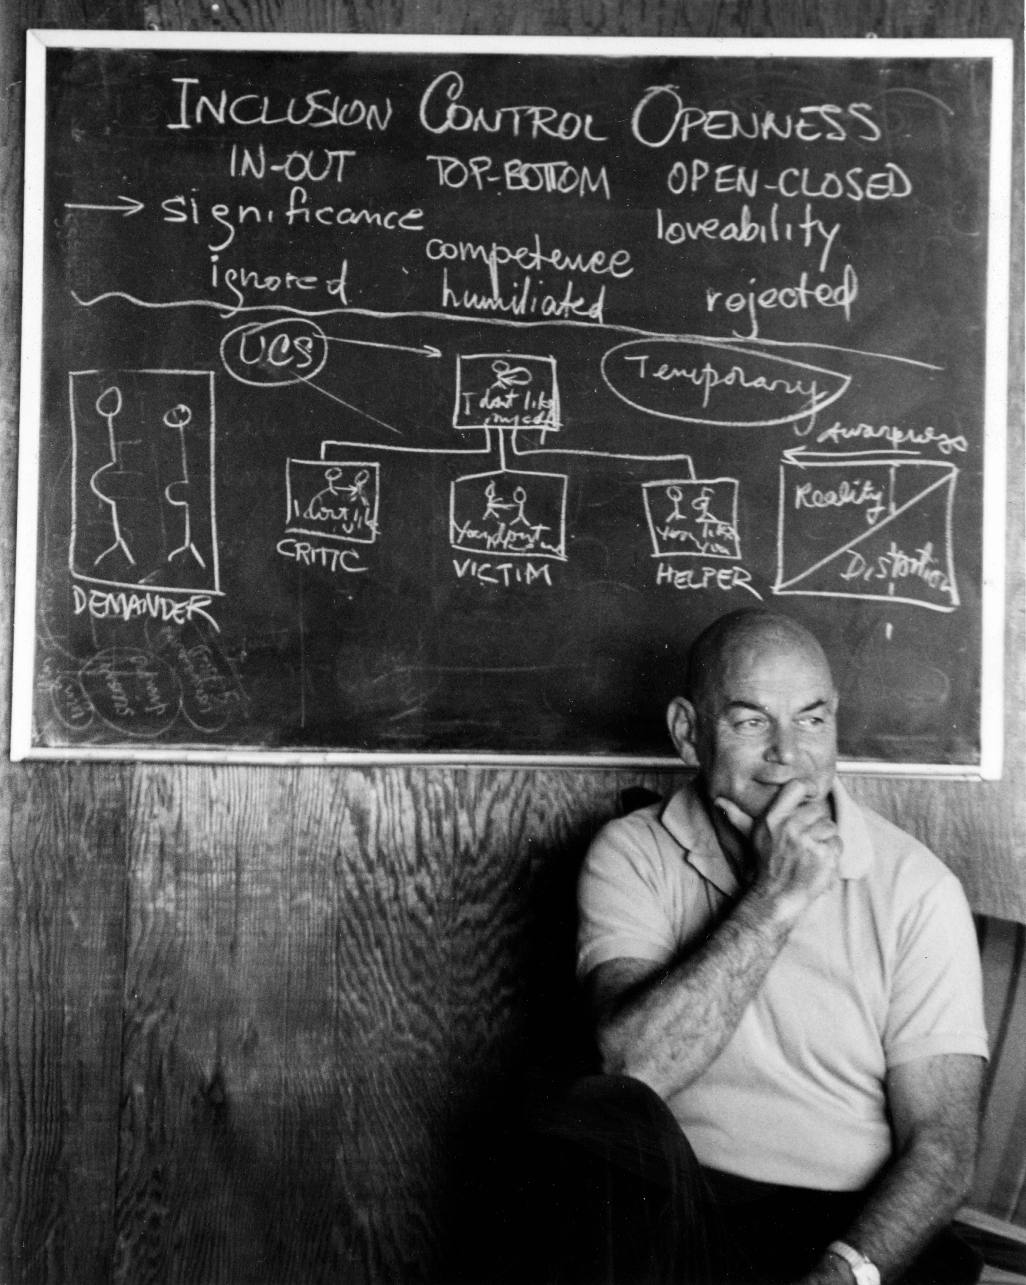
Will Schutz, Ph.D.
1925-2002
© 2015, The Schutz Company. All rights reserved.
Notes:
“…how to integrate the men and machines…”
“When I came to the Naval Research Laboratory they were looking for someone in social science to take care of the man aspect of the man-machine problem. My work … has been therefore to try to devise methods and in order to do this to get basic information about how men can work most productively together, what are the most effective ways of constructing teams so that men will cooperate and be able to function at a high level of efficiency …This work, I might say, is of great interest to me for various reasons. One is the obvious application that I mentioned; another is that it has many implications for basic psychological work, which I am of course interested in. And the third is a personal reason which I think originated very early in my life and which I can trace at least as far back as high school. …The thing that I am really mainly interested in as far as my social and political and academic beliefs are concerned is the dignity of individual people, the possibility of having people realize themselves, …In the work that I am doing I am working with a concept called compatibility, and the main idea of this is the following: that if people are basically compatible as far as their personalities are concerned, they will be able to work together efficiently. This means that you can take someone who is ordinarily quite rejected by the rest of his fellow members or crew members, whatever the situation, and put him in a group in which he will be accepted and he will be able to express himself to a very considerable degree. Now this has the practical advantage of making the team more productive. It also has, what is for me, a very satisfying advantage in helping someone to realize himself personally. [This stems] from my interest in things that are called in the political sphere civil liberties and psychologically they are called free expression and self realization, and terms of this type. And I think that most of the strong feelings that I had toward particular issues stem from this one basic feeling that I have in general.”

Slide 6
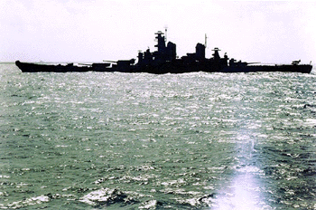
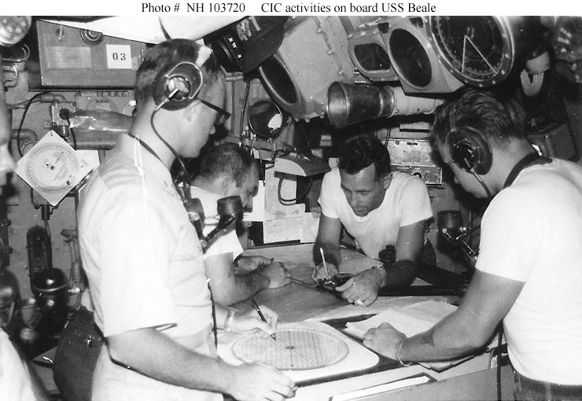
© 2015, The Schutz Company. All rights reserved.
Notes:
Original research
Technical competence a given
C-P effect, magnified when under pressure
Applied to tasks where interdependence is higher

Slide 7
Technical competence
Compatibility
People working well together
© 2015, The Schutz Company. All rights reserved.

Slide 8
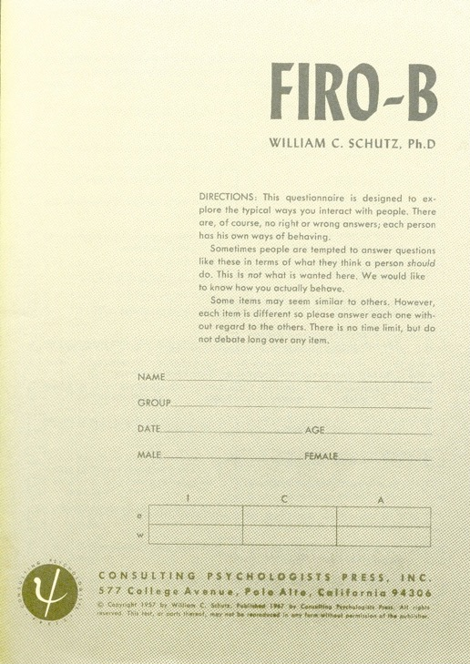
FIRO®
Fundamental
Interpersonal
Relations
Orientation
© 2015, The Schutz Company. All rights reserved.

Slide 9
C P
Compatibility is directly
related to Productivity
© 2015, The Schutz Company. All rights reserved.
Notes:
Technical competence given

Slide 10
C P
Productive teams created randomly:
50%
Productive teams created using FIRO:
75%
© 2015, The Schutz Company. All rights reserved.
Notes:
Technical competence given

Slide 11
© 2015, The Schutz Company. All rights reserved.
Notes:
Technical competence given

Slide 12
Behavior | Inclusion | Control | Openness
© 2015, The Schutz Company. All rights reserved.

Slide 13
Inclusion
0 | 1 | 2 | 3 | 4 | 5 | 6 | 7 | 8 | 9
Low
High
The amount of contact with other people
© 2015, The Schutz Company. All rights reserved.

Slide 14
Control
0 | 1 | 2 | 3 | 4 | 5 | 6 | 7 | 8 | 9
Low
High
The structure of interaction with other people, including directing and decision-making
© 2015, The Schutz Company. All rights reserved.

Slide 15
Openness
0 | 1 | 2 | 3 | 4 | 5 | 6 | 7 | 8 | 9
Low
High
The depth of the interaction with other people—expressing feelings, thoughts, and beliefs
© 2015, The Schutz Company. All rights reserved.

Slide 16
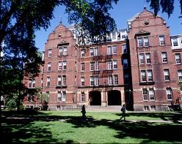
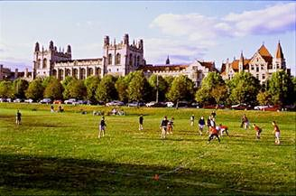
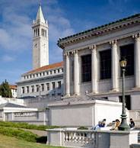
Harvard
University of Chicago
University of California Berkeley
Albert Einstein School of Medicine
© 2015, The Schutz Company. All rights reserved.
Notes:
Berkeley – large study on FIRO theory
Einstein – work with psychotic patients. Noticed that the “outlaws”—NTL, encounter people--did better. Talked to people, listened, used body methods.

Slide 17
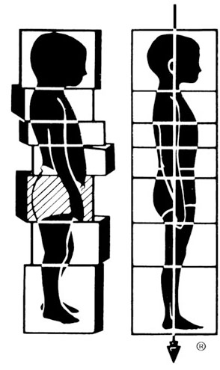
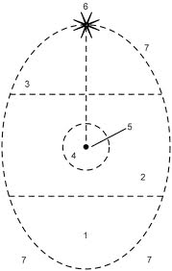
Psychodrama
Bioenergetics
Psychosynthesis
Rolfing
© 2015, The Schutz Company. All rights reserved.

Slide 18
Truth
Personal truth = Sum total of my experience:
Feelings
Thoughts
Self-talk
State of my body
Memories
Sensations
Assumptions
Beliefs
© 2015, The Schutz Company. All rights reserved.

Slide 19
Openness
My experience
Body language
Slips
Tone
Unaware
Aware
Withholding
Distorting
Honesty
Misleading
Lying
Spin
White lies
You
© 2015, The Schutz Company. All rights reserved.

Slide 20
I pretend…
…to trust people who I don’t.
…to listen to people when I’m not.
…to respect certain people when I don’t.
…to agree when I don’t.
…I don’t have to be right or get my way.
…to be patient.
…I want to be collaborative.
…I’m not feeling critical.
© 2013, The Schutz Company. All rights reserved.

Slide 21
I pretend…
…not to be frustrated when I am.
…to know what I am doing when I don’t.
…not to be afraid when I am.
…I don’t want more recognition.
…to want other people’s opinions.
…I have things under control.
…I want feedback.
…to say what I think and feel.
© 2013, The Schutz Company. All rights reserved.

Slide 22
© 2015, The Schutz Company. All rights reserved.
Notes:
Technical competence given

Slide 23
Inclusion Low High | Control Low High | Openness Low High
Ignored/Abandoned | Humiliated/Embarrassed | Rejected/Disliked
© 2015, The Schutz Company. All rights reserved.

Slide 24
Rigidity
Enemy of teamwork and collaboration
© 2013, The Schutz Company. All rights reserved.

Slide 26
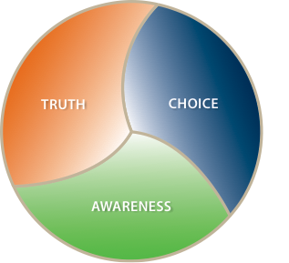

Slide 27
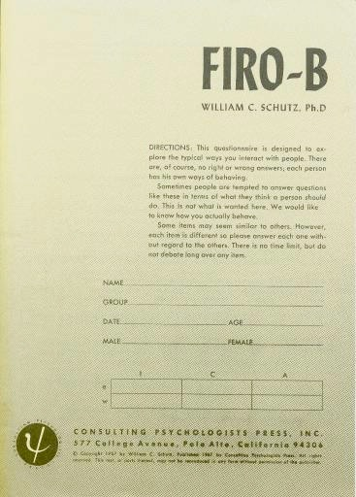
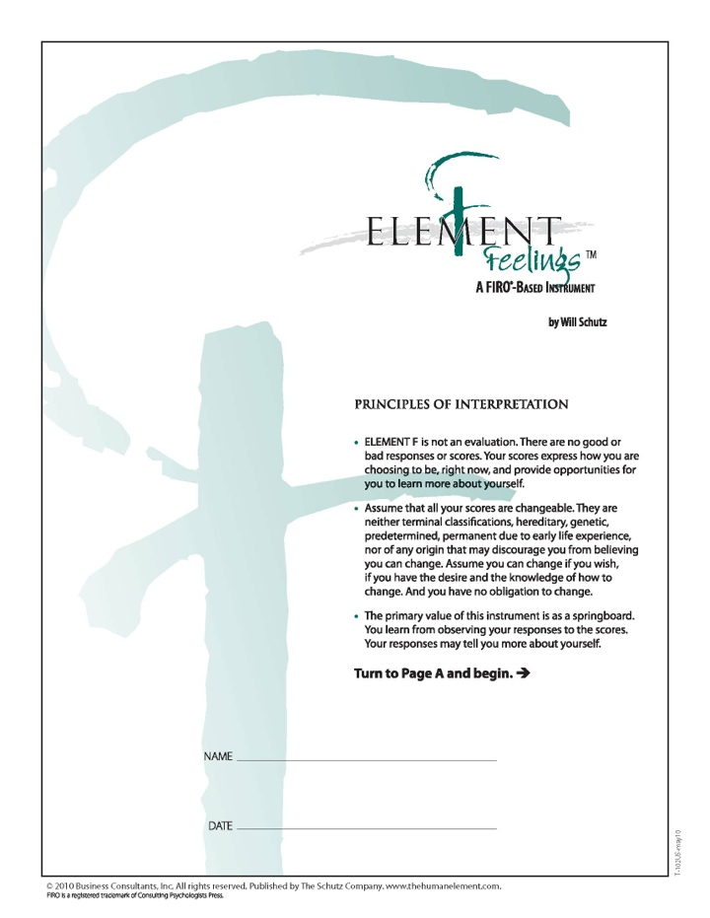
Behavior | Inclusion | Control | Openness
Feelings | Significance | Competence | Likability
Self-Concept (behavior) | Aliveness | Self-Determination | Self-Awareness
Self-Concept (feelings) | Self-Significance | Self-Competence | Self-Like
© 2015, The Schutz Company. All rights reserved.

Slide 28
Behavior | Inclusion | Control | Openness
Feelings | Significance | Competence | Likability
Self-Concept (behavior) | Aliveness | Self-Determination | Self-Awareness
Self-Concept (feelings) | Self-Significance | Self-Competence | Self-Like
© 2015, The Schutz Company. All rights reserved.

Slide 29
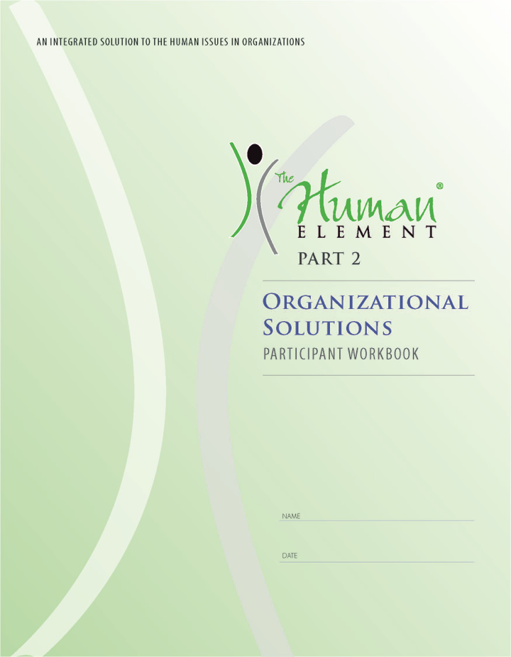
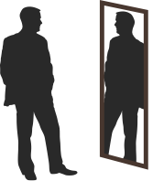
Feedback
Imagery/Visualization
Assessment Tools
Structured
Experiences
Self-Perception
© 2015, The Schutz Company. All rights reserved.

Slide 30
Applications
Leadership
Teamwork
Individual effectiveness
Decision making
Job fit
Collaboration
Customer service
Cultural alignment
© 2015, The Schutz Company. All rights reserved.

Slide 31
An ideal organization
Accountability
Openness
Self-regard
Job Fit
Decision Making
Personal Development
Leadership
Productivity
Results
© 2015, The Schutz Company. All rights reserved.

Slide 32
www.TheHumanElement.com
Your email
© 2015, The Schutz Company. All rights reserved.

