Slide 2
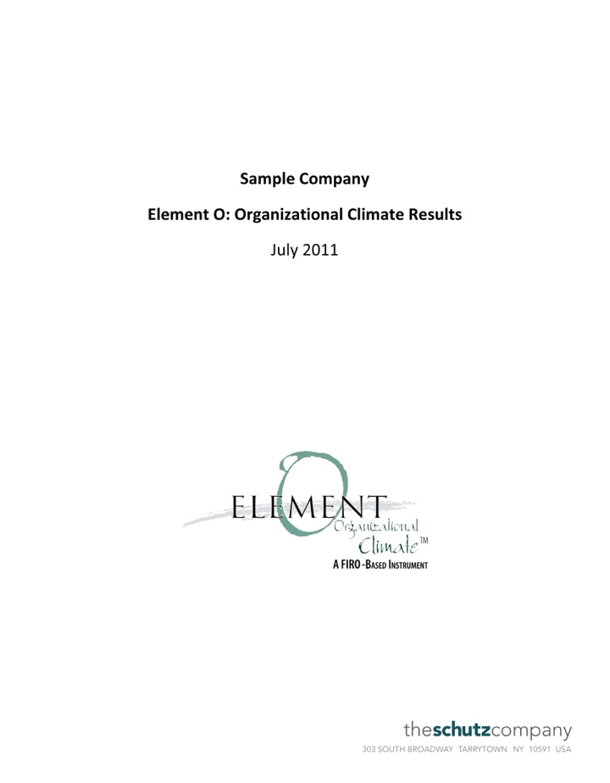
Element O: Organizational Climate
Measures the climate or atmosphere in the organization

Slide 3
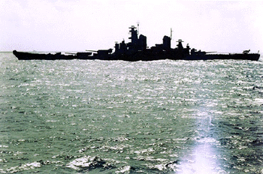
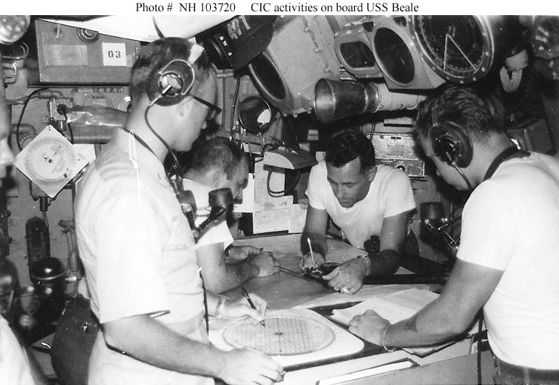
What Makes Groups Productive?
1952 research
US Navy
Combat Information Center

Slide 4
What Makes Groups Productive?
Technical competence
Compatibility:
People working well together

Slide 5
What Makes Groups Productive?
Working well together
is driven by…
Individual feelings about oneself in the organization

Slide 6
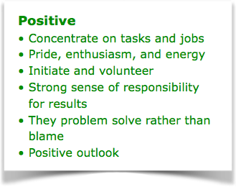
What Makes Groups Productive?
How we feel about ourselves at work

Slide 7
What Makes Groups Productive?
To increase productivity…
We create an organizational atmosphere in which people feel positive about themselves

Slide 8
Organizational Goals
 |  | Organization facilitates an atmosphere of…
 |  | Participation
 |  | Empowerment
 |  | Openness
 |  | Recognition
 |  | Reward
 |  | Humanity

Slide 9
Organizational Goals
 | Individuals feel… | Organization facilitates an atmosphere of…
 | Alive | Participation
 | Self-determined | Empowerment
 | Self-aware | Openness
 | Significant | Recognition
 | Competent | Reward
 | Likable | Humanity

Slide 10
Organizational Goals
 | Individuals feel… | Organization facilitates an atmosphere of…
Inclusion | Alive | Participation
Control | Self-determined | Empowerment
Openness | Self-aware | Openness
Significance | Significant | Recognition
Competence | Competent | Reward
Likability | Likable | Humanity

Slide 11
Dimensions Measured
Inclusion
The amount of contact with other people
Control
The structure of interaction with other people, including directing and decision-making
Openness
The depth of the interaction with other people—expressing feelings, thoughts, and beliefs

Slide 12
Dimensions Measured
Significance
Feeling important, worthwhile, and meaningful
Competence
Feeling capable, intelligent, and self-sufficient
Likability
Feeling good about oneself in the presence of others

Slide 13
Dimensions Measured
Productivity
Satisfaction with performance

Slide 14
Survey Report
Scores are given on a scale of 0-100, indicating the percentage of people accepting the idea.
See
Want
Difference scores are the gaps between the See and Want scores.

Slide 15
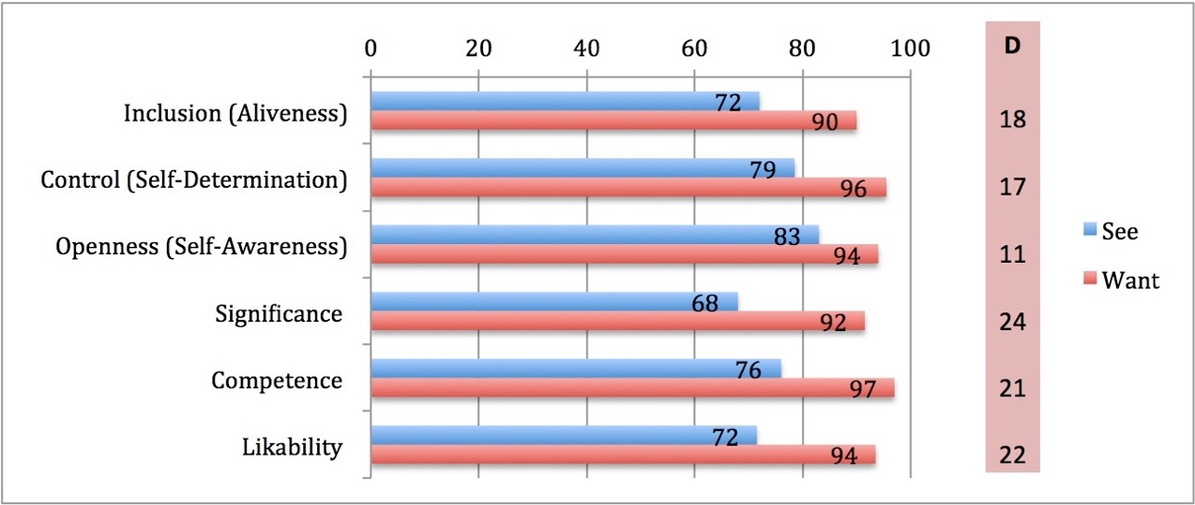
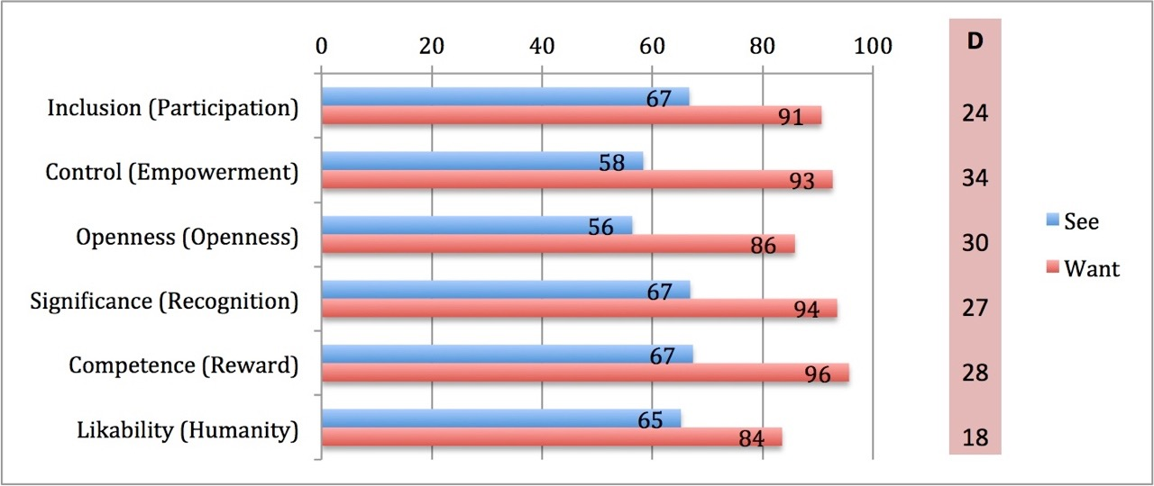
Survey Report
 | Individuals feel… | Organization facilitates an atmosphere of…
Inclusion | Alive | Participation
Control | Self-determined | Empowerment
Openness | Self-aware | Openness
Significance | Significant | Recognition
Competence | Competent | Reward
Likability | Likable | Humanity

Slide 16
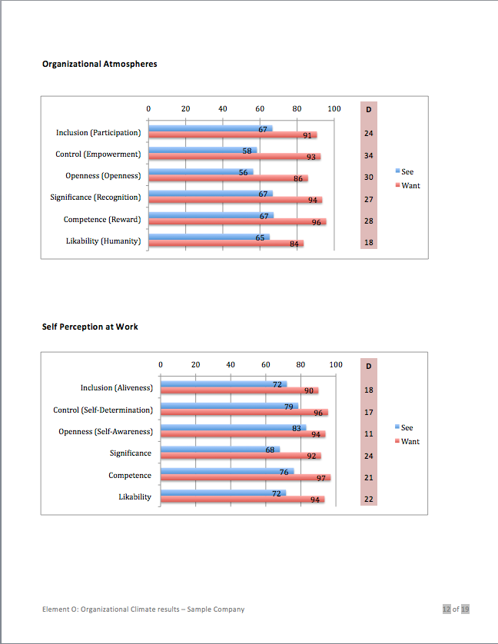
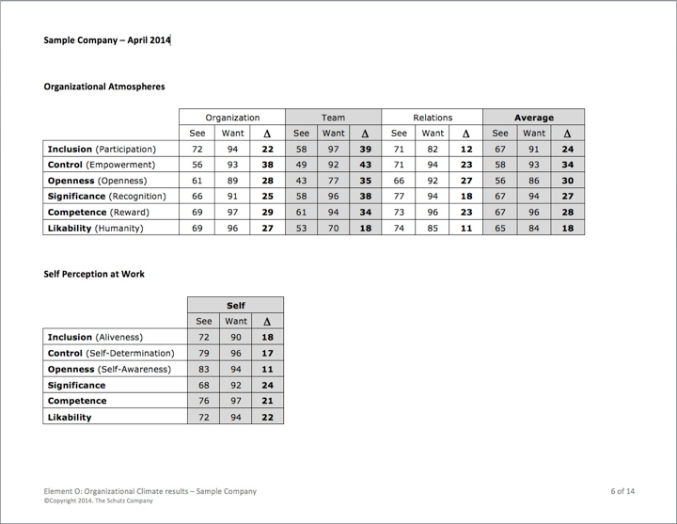
Survey Report
Organization
Team
Relations

Slide 17
Survey Report

Slide 18
Survey Report

Slide 19
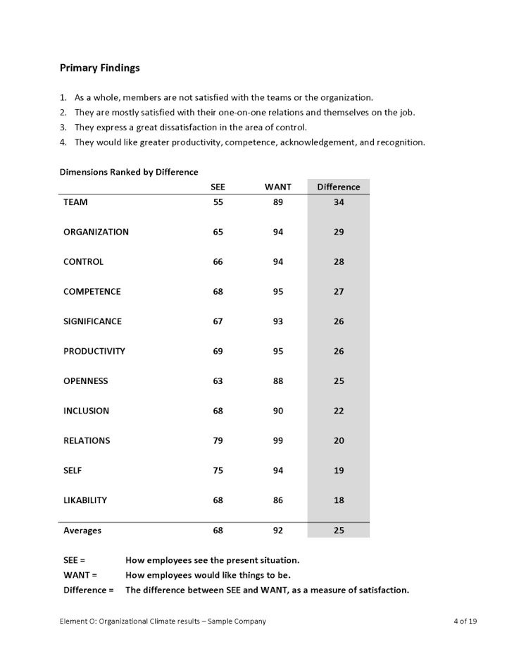
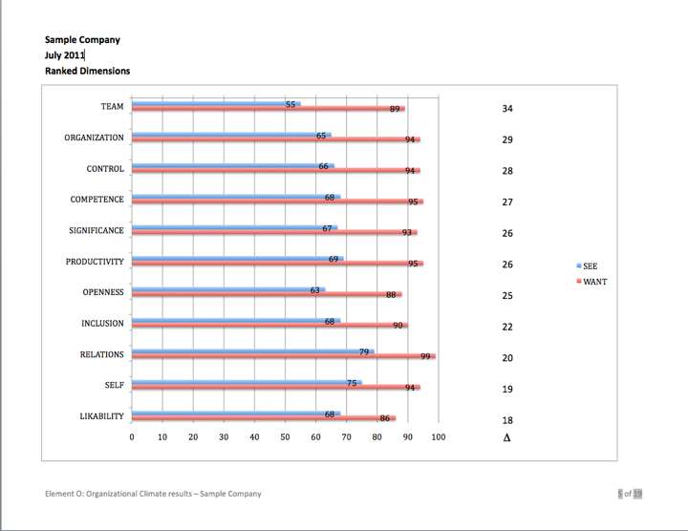
Survey Report
All dimensions

Slide 20
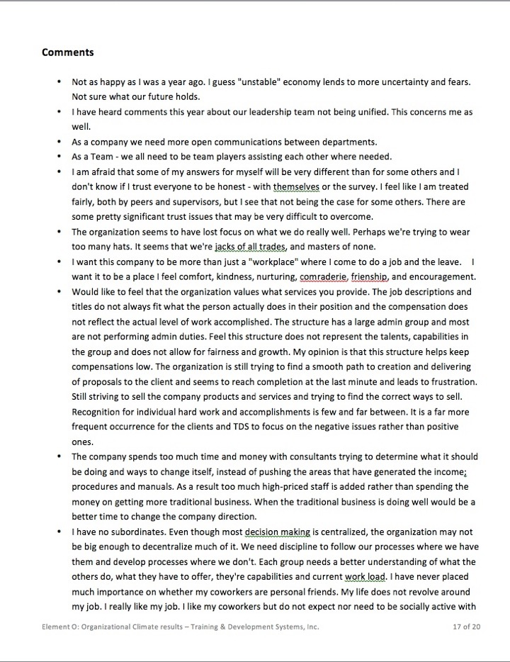
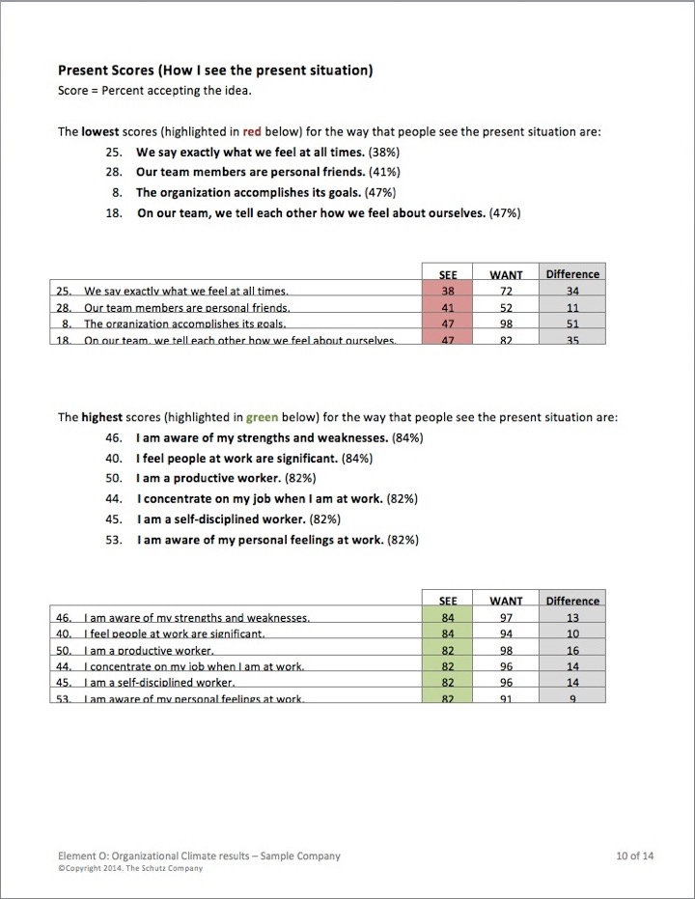
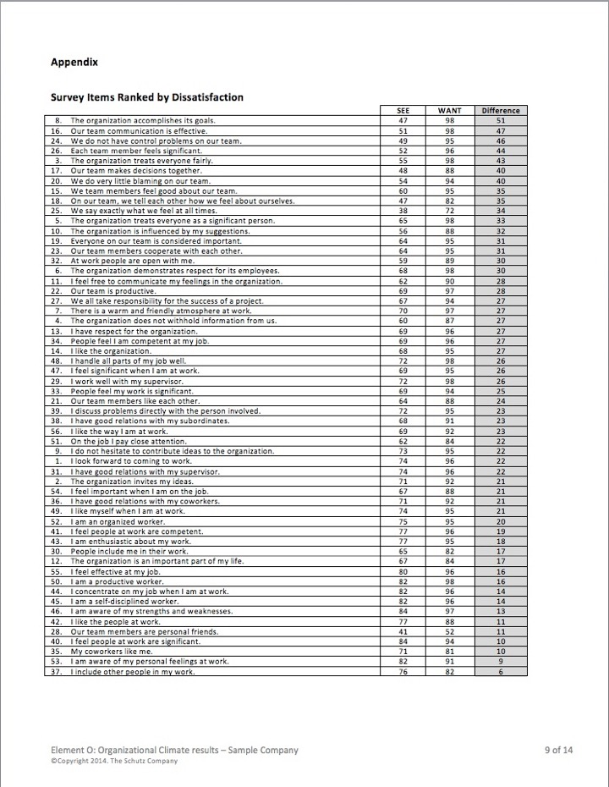
Survey Report
Comments
High/Low
All items

